Slide 1
6. The Role of the Nonprofit
Topic 1. What is a Business?
Chapter 1. Business Basics.
Unit 1. The Context of Business.
MXA101 – Introduction To Business
-By ManageX Academy

Slide 2
Introduction to Nonprofit Organizations
Understanding the concept of nonprofits
Difference between profit-driven and purpose-driven organizations
Social impact as the main focus
Role of nonprofits in economic and community development

Slide 3

What is a Nonprofit Organization?
Organization formed for a mission, not for profit
Does not distribute earnings to owners
Surplus revenue is reinvested into objectives
Can operate with staff or volunteers
Legally recognized entity

Slide 4
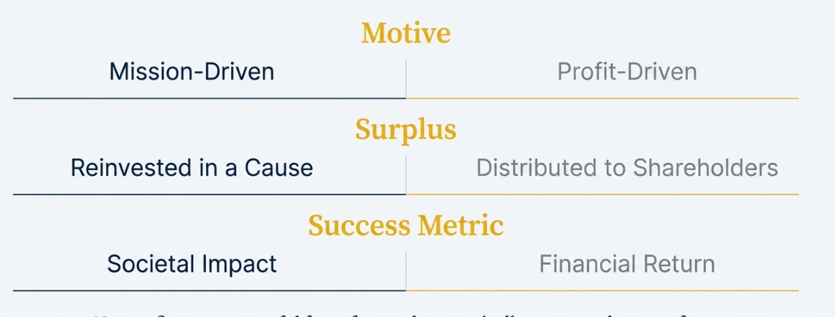
Surplus vs Profit in Nonprofits
Surplus allowed
No dividends to shareholders
Earnings used for expansion
Funds retained for sustainability
Financial discipline still important

Slide 5
Legal Forms of Nonprofits
Can be registered as:
  Corporations
  Trusts
  Cooperatives
Informal nonprofits also exist
Governance structure required
Jurisdiction defines operations

Slide 6
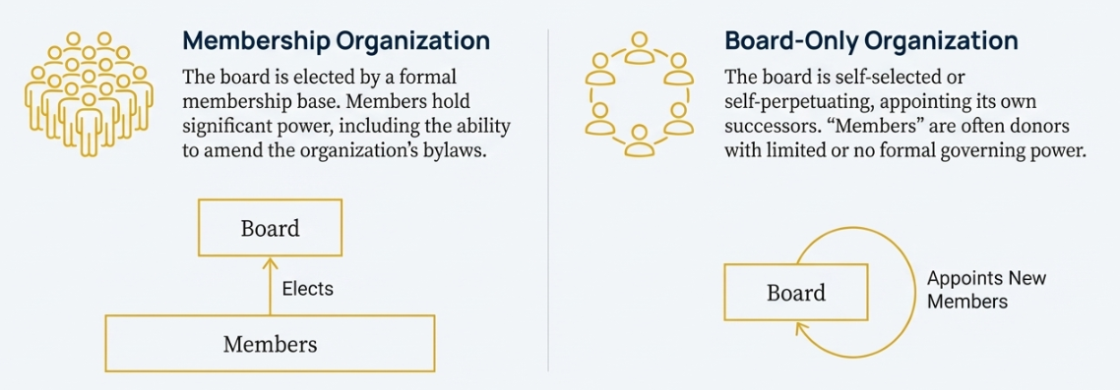
Governance in Nonprofits
Board members or trustees govern the NPO
Fiduciary duty towards organization
Duty of loyalty and trust
Accountability to donors and community
Strategic supervision required

Slide 7
Staffing Structure
Many nonprofits have paid staff
Use of:
  Volunteers
  Unpaid executives
Nominal compensation possible
Mix of professional managers and helpers

Slide 8
Financial Reporting Requirements
Large NPOs publish financial statements
Income and expenditure transparency
Auditing provisions
Accountability to funding sources
Ethical fund management

Slide 9
Types of Nonprofit Organizations
Membership-based organizations
Board-only organizations
Donor-supported institutions
Charitable and service organizations
Foundations and supporting organizations

Slide 10
Tax Exemption Concept
NPOs may receive tax benefits
Donations often tax deductible
Exemption depends on compliance
Government oversight important
Tax status helps social missions grow

Slide 11

Role of Nonprofits in Society
Support arts and culture
Aid health and wellness sectors
Promote education and awareness
Help community development
Work for social harmony

Slide 12
Community Orientation
Strong local ties
Focus on real community needs
Build trust and relationships
Long-term social impact
Outreach programs

Slide 13
Why Study Nonprofits?
Understand social impact management
Learn ethical leadership
Develop organizing skills
Balance mission and resources
Broader career understanding

Slide 14
Nonprofit as Organized System
Composition of individuals and groups
Coordinated goals
Structured organizing
Professional accountability
Strategic planning

Slide 15
Conclusion
Nonprofits drive community progress
Mission over profit
Governance ensures trust
Financial discipline builds sustainability
Essential part of modern business ecosystem

Slide 16


